Slide 1
Blah

Slide 2
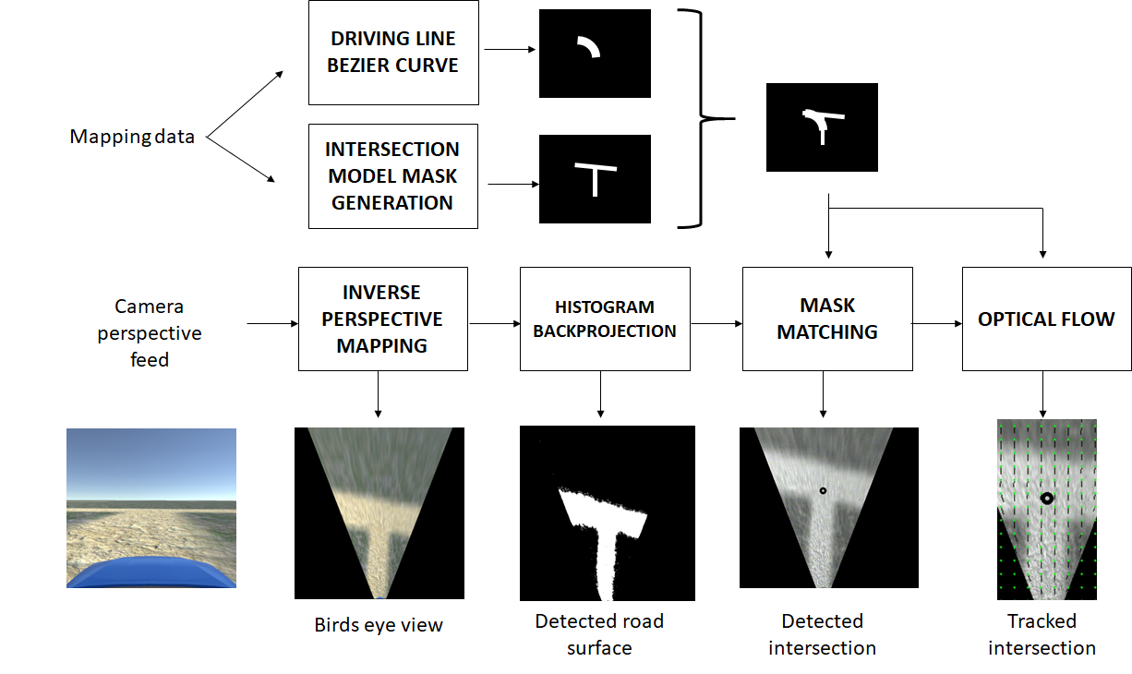
Single camera navigation localisation
Route feature detection and tracking
Driving line development
Modular with defined I/O
Swap out individual module implementations
Human interpretable
….

Slide 3
Original scope
Intersection detection from still image
Restrictions
No other vehicles
Detectable road surface
Extension
Driving line confirmation and intersection tracking

Slide 4





Mask Matching
$$M$$
$$I_{original}$$
$$I_{masked}$$
Hadamard product
$$I_{masked}=M∘I_{original}$$

Slide 7
IPM

Slide 8
IPM

Slide 9
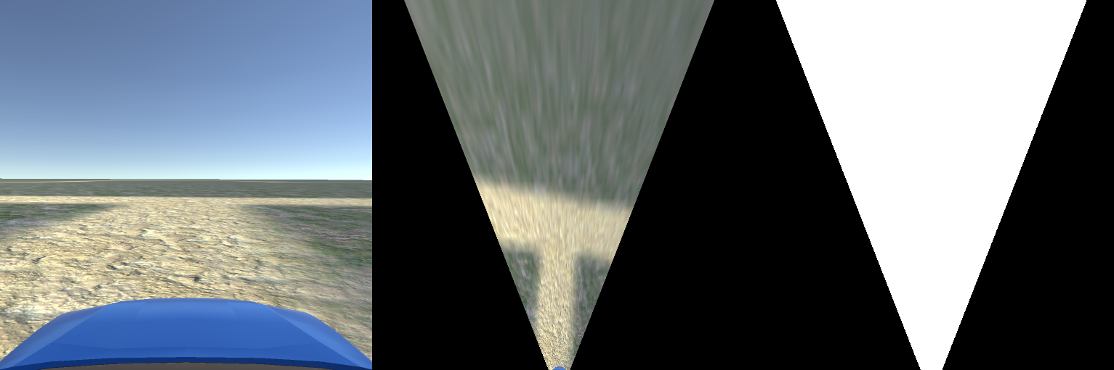
IPM
5m
5m
100px

Slide 12
Histogram Backprojection
Colour historgram (OpenCV demo?)
IPM with box

Slide 13
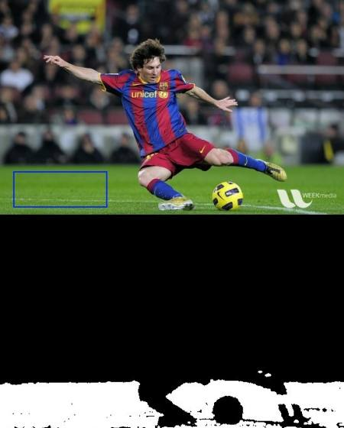
Histogram Backprojection
Colour historgram (OpenCV demo?)
IPM with box
https://docs.opencv.org/master/dc/df6/tutorial_py_histogram_backprojection.html

Slide 14
Histogram Backprojection
Colour historgram (OpenCV demo?)
IPM with box
IPM with ROI
Detected road surface
https://docs.opencv.org/master/dc/df6/tutorial_py_histogram_backprojection.html

Slide 17
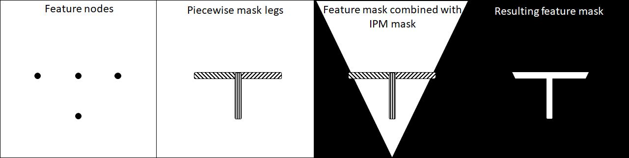
Feature mask generation

Slide 20
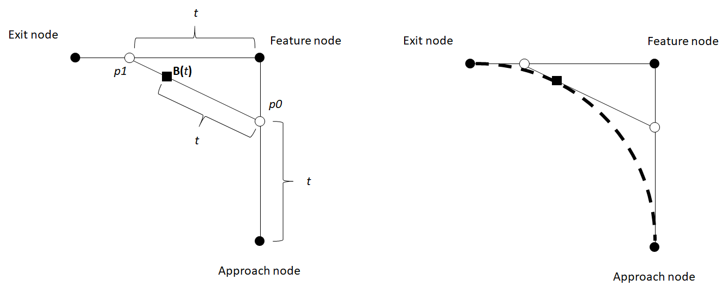
Driving line generation

Slide 24
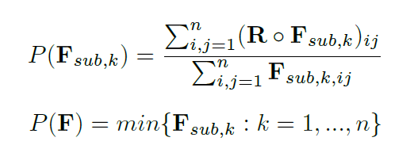


Mask Matching
Detected road
Feature mask

Slide 25
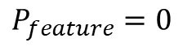
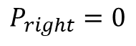
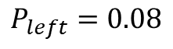
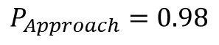
Mask Matching
$$P_{Approach}=0.98$$
$$P_{left}=0.08$$
$$P_{feature}=0$$
$$P_{right}=0$$

Slide 26

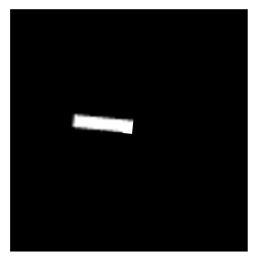
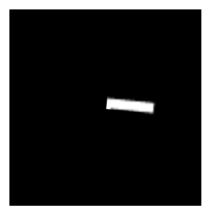
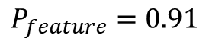
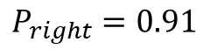
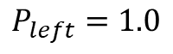
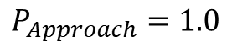
Mask Matching
$$P_{Approach}=1.0$$
$$P_{left}=1.0$$
$$P_{feature}=0.91$$
$$P_{right}=0.91$$

Slide 29
Optical flow
(2,3)

Slide 30
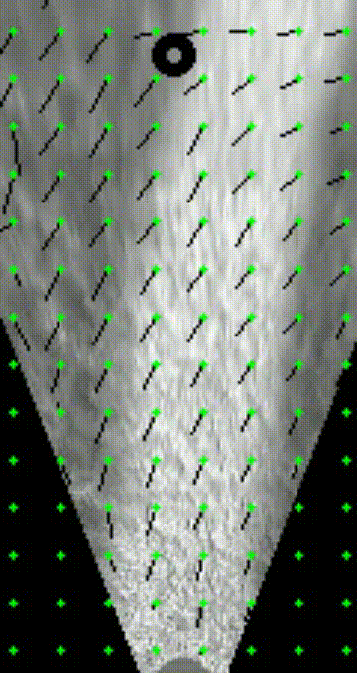
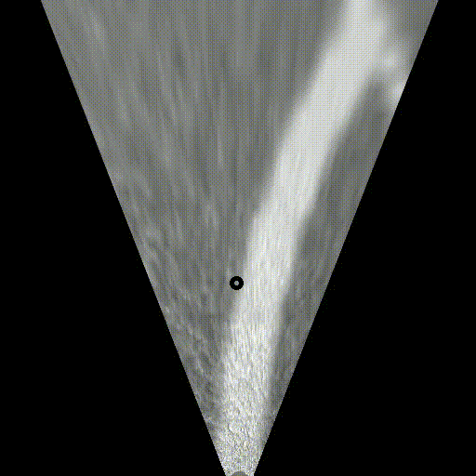
Optical flow
Gunnar Farnebäck optical flow algorithm:
“Two-Frame Motion Estimation Based on Polynomial Expansion”

Slide 32
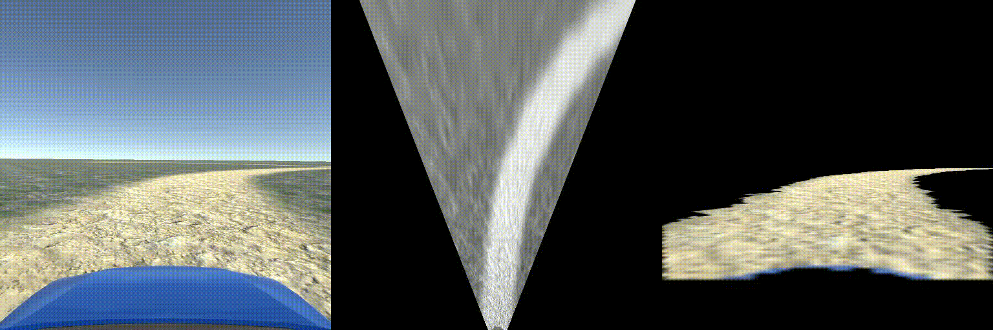
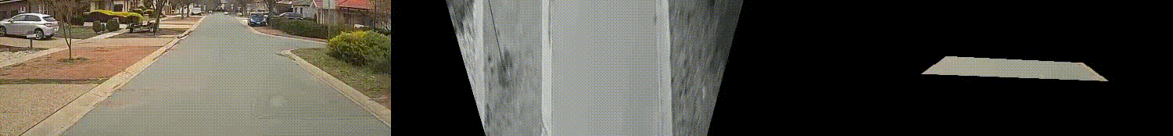

Slide 33
QUESTIONS

Slide 34
Resuts
Hough transform for lane edges
Camera distortion correction (fisheye)
Other intersections
IPM ‘width’
Optical flow performance

Slide 36
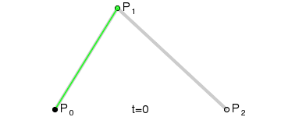
From: https://en.wikipedia.org/wiki/B%C3%A9zier_curve

Slide 37
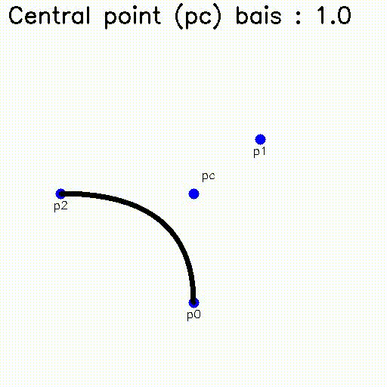

Slide 38
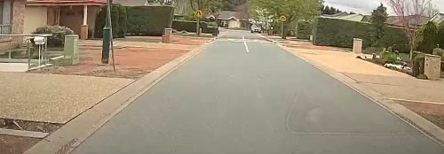
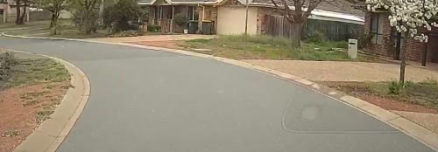
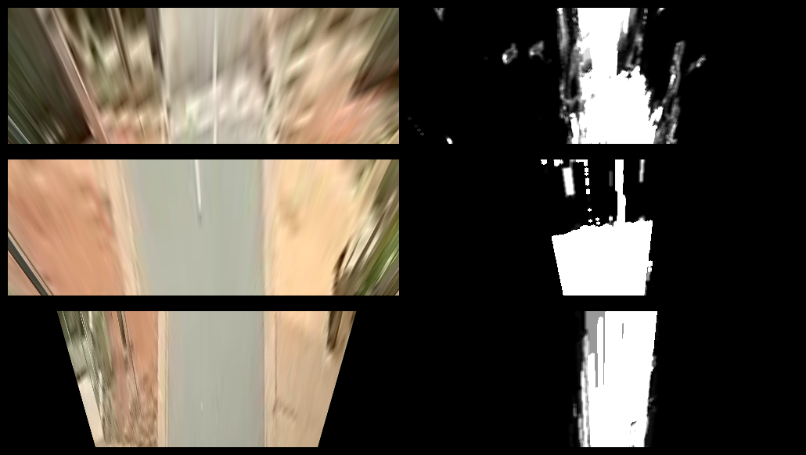
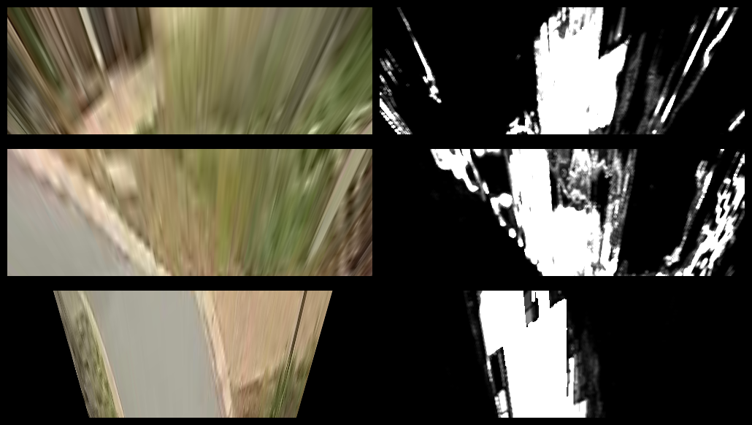

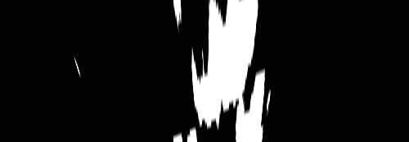



Slide 39
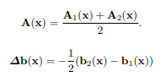
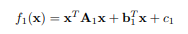
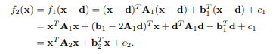
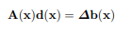
Optical flow
Two-Frame Motion Estimation Based on Polynomial Expansion
Gunnar Farnebäck
http://www.diva-portal.org/smash/get/diva2:273847/FULLTEXT01.pdf

Slide 40
Bezier Curves

